Slide 1
LGB
OPERATIONS TECHNOLOGY
October 2026
Weekly Project Progress
Robotic Automation Projects
Stellantis • Daimler • Helical • Ather • BMW RAD
LGB | Operations Technology

Slide 2
PROJECT OVERVIEW
S.No | Project | Process Scope | Robots / Cobots | Start Date | End Date | Current Status
1 | Stellantis line 1-Phase | OP10 , Ultrasonic washing , Vision , OilWashing | 2 × UR12e Cobots | 07-07-2025 | 20-07-2026 | Installation & inprogress
2 | Helical Line | OP10 → OP20 | 2 UR12e Cobot + 1 yaskawa 20kg robot | 31-03-2026 | 20-10-2026 | 2 Cobot cell installation & commissioning inprogress
3 | Daimler Line | OP10 → OP20 | 4 × UR12e Cobots | 24-04-2026 | 15-10-2026 | One cell production trail done, To start program for next cell
4 | Ather Line | OP10 → OP20 | 5 × ABB 12kg Cobots | 15-02-2026 | 24-10-2026 | Waiting for FAT
5 | BMW RAD Line | OP10 → OP20→OP30→OP40 | 4 Cobots + 1 AMR | 02-02-2026 | 28-10-2026 | DAP Review Pending
LGB l Operations Technology

Slide 3
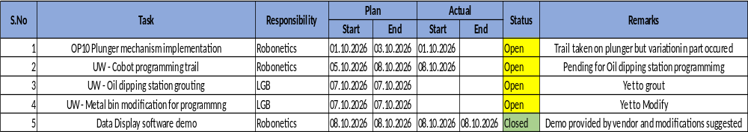
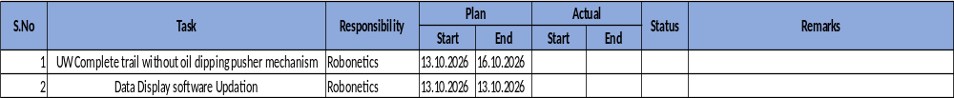
STELLANTIS LINE - PHASE 1
WEEK 01 (PLAN vs ACTUAL)
WEEK 02 (PLANNED ACTIVITY)
LGB l Operations Technology

Slide 4
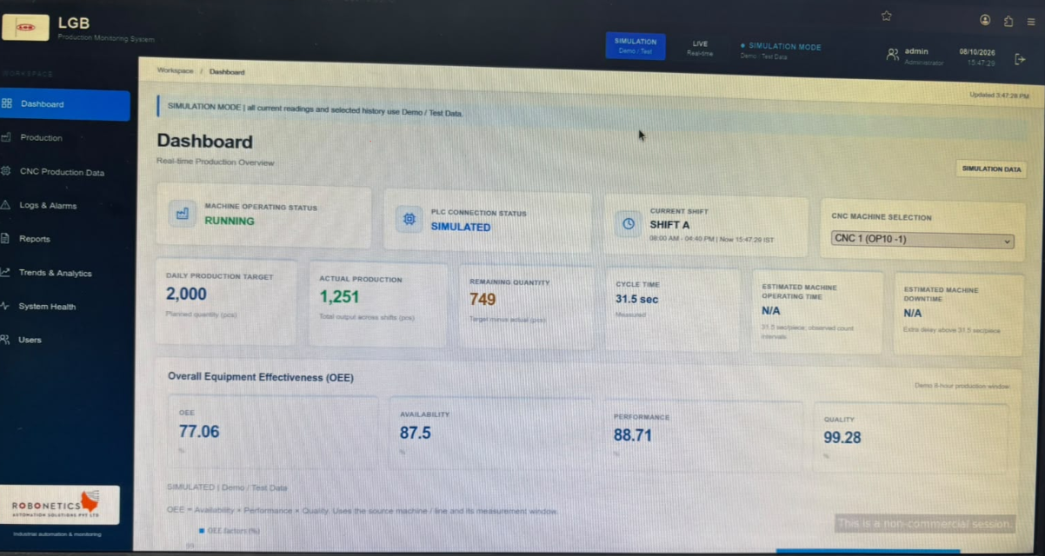
STELLANTIS LINE - PHASE 1
Robonetics Software Demo_Dashboard
LGB l Operations Technology

Slide 5
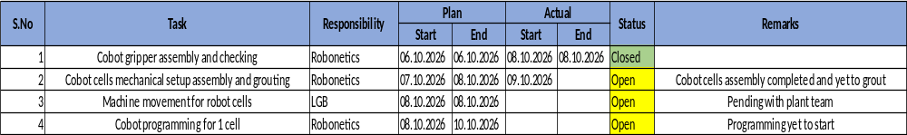
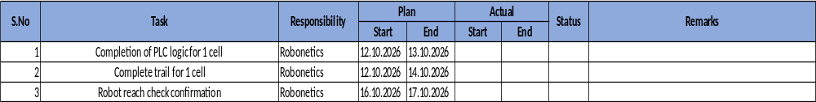
HELICAL LINE
WEEK 01 (PLAN vs ACTUAL)
WEEK 02 (PLANNED ACTIVITY)
LGB l Operations Technology
LGB l Operations Technology

Slide 6
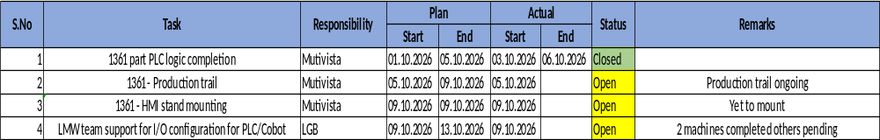
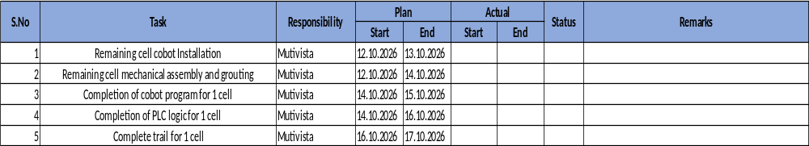
DAIMLER LINE
WEEK 01 (PLAN vs ACTUAL)
WEEK 02 (PLANNED ACTIVITY)
LGB l Operations Technology
LGB l Operations Technology

Slide 7
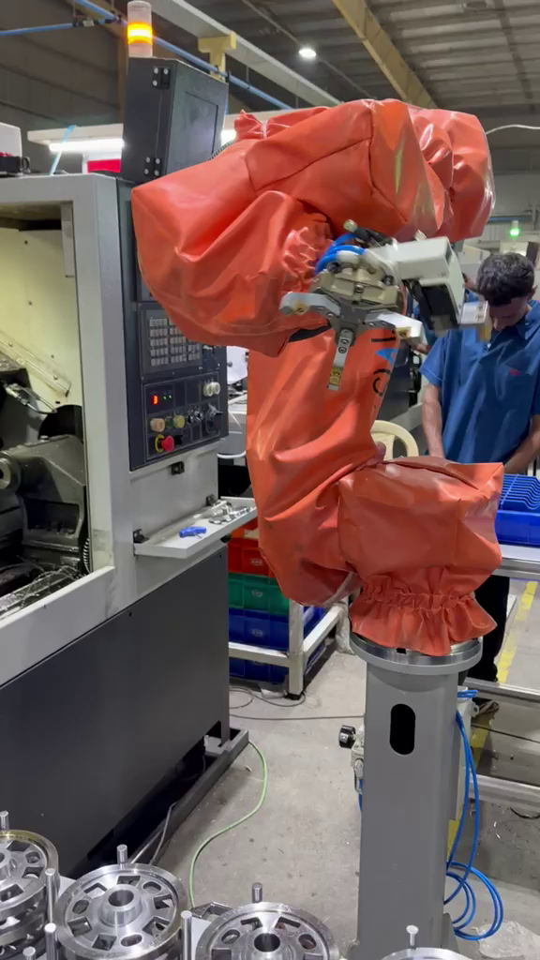
DAIMLER LINE
DAIMLER LINE ONE CELL PRODUCTION VIDEO
LGB l Operations Technology

Slide 8
OTHER PROJECT DETAILS
Project | Description | Team | Planned |  | Actual |  | % Complete | Remarks
 |  |  | Start | Finish | Start | Finish
Ather Project | Cobot received and waiting for FAT | Melss | 14.10.2026 | 15.10.2026
BMW RAD | Revised DAP review pending | Robonetics | 12.10.2026 | 12.10.2026
Timing Mark Sprocket(Gear) | Production trail completed | Smartscope | 05.10.2026 | 09.10.2026 | 05.10.2026 | 09.10.2026 | 100%
Linear Measurement(Ather) | POC completed | Smartscope | 08.10.2026 | 09.10.2026 | 08.10.2026 | 09.10.2026 | 100%
LGB l Operations Technology

Slide 9
October 2026
Weekly Project progress review
LGB | Operations Technology
Thank You

